Slide 1
Rare Beauty
Your Beauty is Rare

Slide 2
Features
Everything you need for you Eyes, lips and face.
full coverage to sheer coverage.
Wide range of colors.
Suitable for all skin types.
Including SPF.
Anti acne
Anti aging

Slide 3
Prices
Foundation
Concealer
Lip gloss
Lip stick
$30
$15
$6
$8

Slide 4
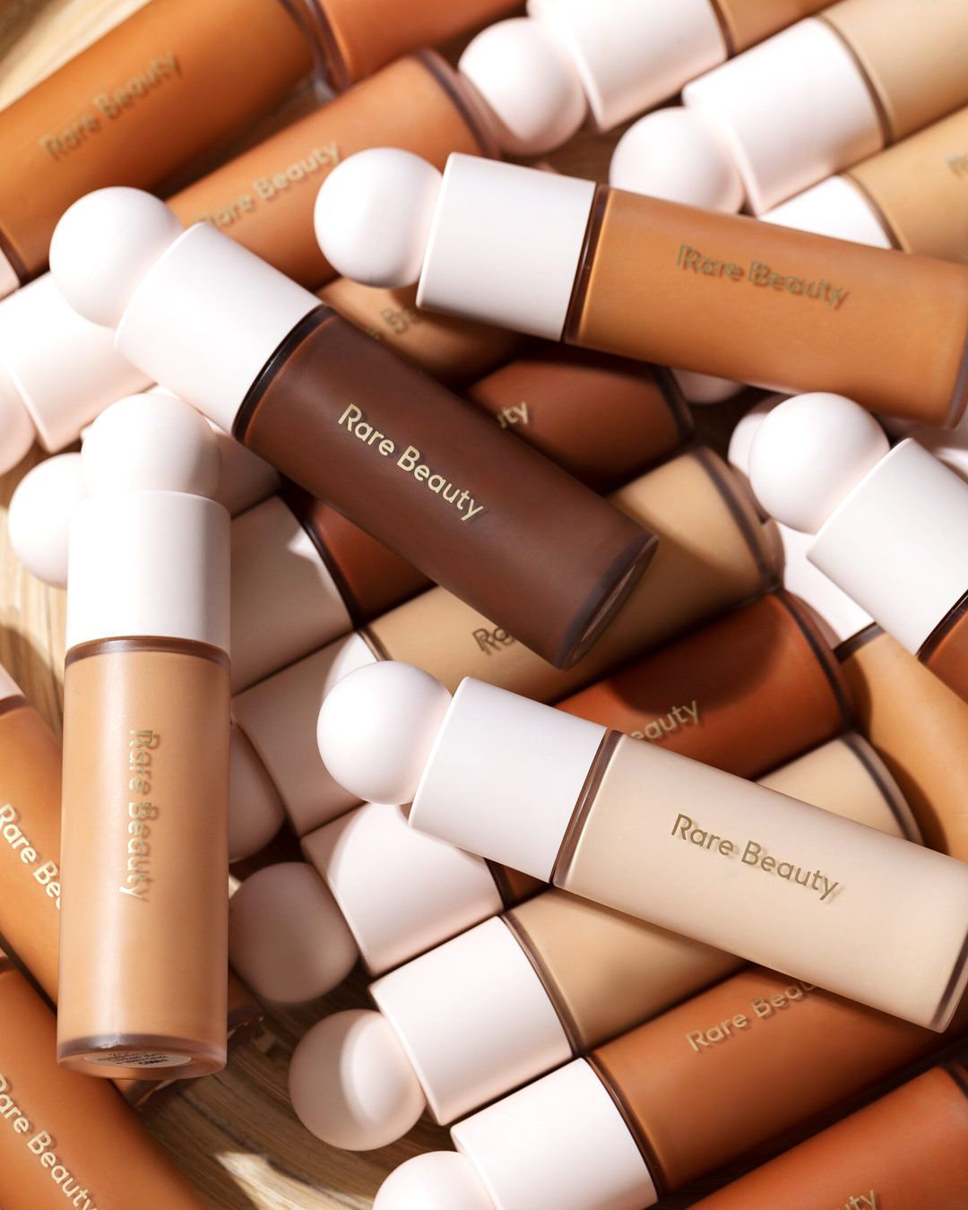
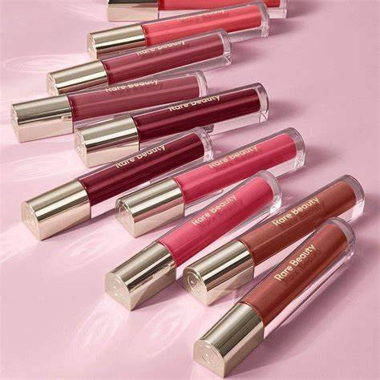
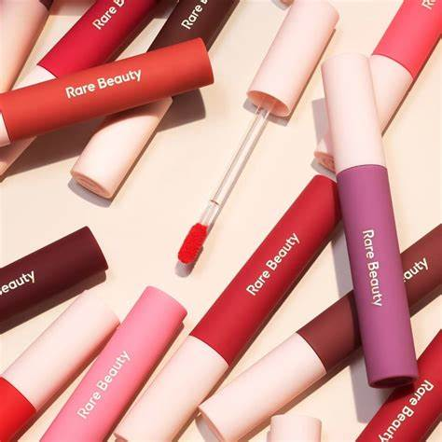
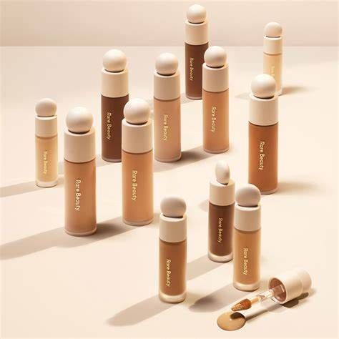
Containers

Slide 5
Thank You!

